Slide 1

Date: | Human Biology Year 12 ATAR
Do Now Past exam question Blood Glucose Homeostasis Lesson Agenda 1: Do Now 2: Body Fluid Homeostasis 3: Lesson summary and wind-up Suggested Study Complete review worksheet, mark and correct using answer key on Connect. Read through today’s notes and textbook section NEXT LESSON Past Exam Question Blood Gas Homeostasis | Learning Aims Describe how fluid is distributed in the body. Discuss ways in which fluid exchange occurs within the body and with the environment. Describe methods of water intake and water loss by the human body. Describe modes of fluid and waste excretion. Detail the role of the renal system in maintaining body fluid composition. Define and explain osmotic pressure and how it is detected. Describe the role of ADH, Aldosterone and the thirst reflex in fluid homeostasis when osmotic pressure increases. Describe the body’s responses when osmotic pressure falls below set point. List causes, symptoms and treatments for dehydration. List causes, symptoms and treatments for water intoxication/hyponatremia
 | Key Vocabulary Aldosterone Anti Diuretic Hormone (ADH) Osmotic Pressure Osmoreceptor Hypothalamus Reabsorption Excretion

Slide 2
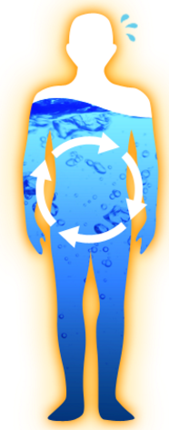
Regulation of Body Fluid Composition
Chapter 6 Human Perspectives

Slide 3
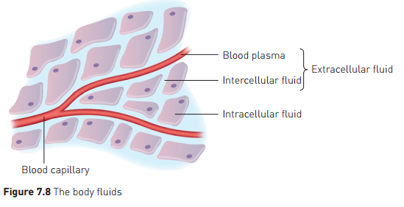
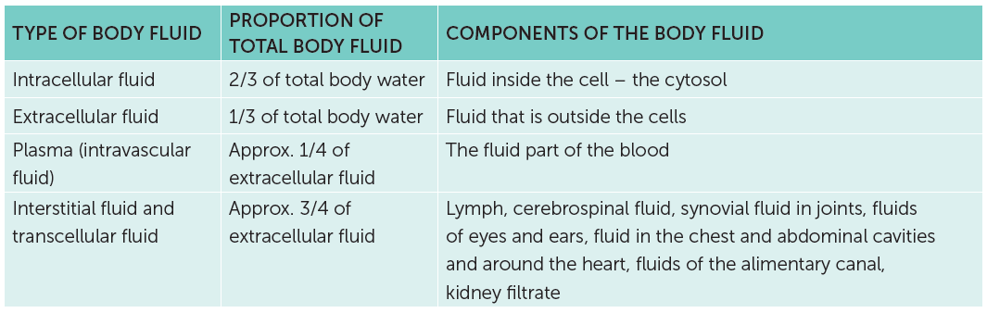
Body Fluid Distribution
The human body is around 60% water
Distributed in different locations
Continual exchange of fluid and materials between locations (compartments)

Slide 4
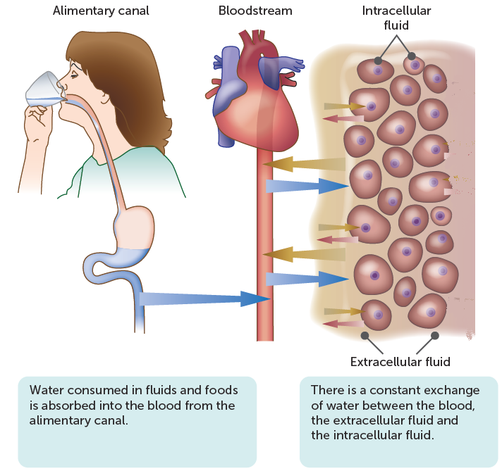
Fluid Exchange
Continuous exchange of fluids eg:
Environment to digestive system
Digestive system to blood
Between blood and intercellular (interstitial) fluid
Between interstitial fluid and lymph
Between interstitial fluid and cytoplasm
Between blood and excretory systems
Between excretory systems and environment
Water and dissolved substances move freely through membranes
Diffusion
Osmosis

Slide 5
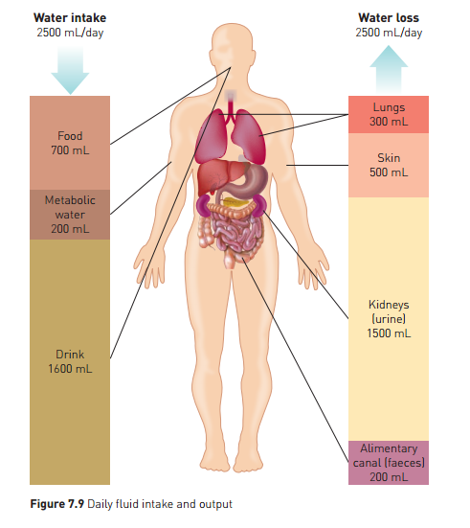
Fluid Balance
Fluid gain must equal fluid loss
Fluid composition must also remain steady
Ion concentration
Glucose concentration
Nitrogenous waste concentration
pH
Blood gas concentration

Slide 6
Excretion and fluid balance
Removal of metabolic products so they do not build up in body fluids
Lungs:
Carbon dioxide excretion
Some water also lost by evaporation
Sweat glands:
Secrete water, with salts, urea, lactic acid
Digestive (alimentary) canal
Bile pigments, products of haemoglobin breakdown
Water also lost
Kidneys
Main excretory organs
Maintain body fluid levels and balance solute concentrations
Urea removed also

Slide 7
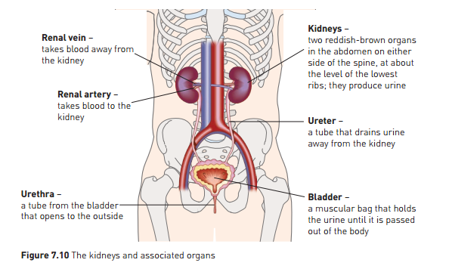
Renal system
Primary mechanism for regulation of body fluid composition.
Filters blood, removes waste products and balances ion concentration.

Slide 8
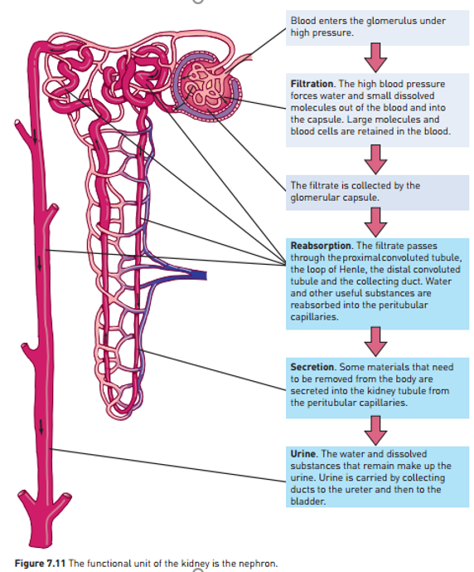
The Nephron
Functional Unit of the kidney.
FILTRATION
Fluid component of blood filtered at glomerulus
REABSORPTION
Water and useful substances are reabsorbed under homeostatic control to maintain constant body fluid composition
SECRETION
Some additional substances are removed from blood into the kidney tubule.

Slide 9
Renal System Role in Body Fluid homeostasis
Renal system balances secretion and reabsorption of water to maintain fluid volume:
Too little water: urine concentrated
Too much water: urine dilute, produced faster
Reabsorption of water
Proximal convoluted tubule and loop of Henle: via osmosis
Distal convoluted tubule and collecting duct: active transport
Active reabsorption controlled by ADH (Anti-diuretic Hormone)
Reabsorption of sodium ions
Distal convoluted tubule and collecting duct
controlled by Aldosterone
Increased Na+ reabsorption and K+ excretion via Na+/K+ pump
Water moves via osmosis with Na+

Slide 10
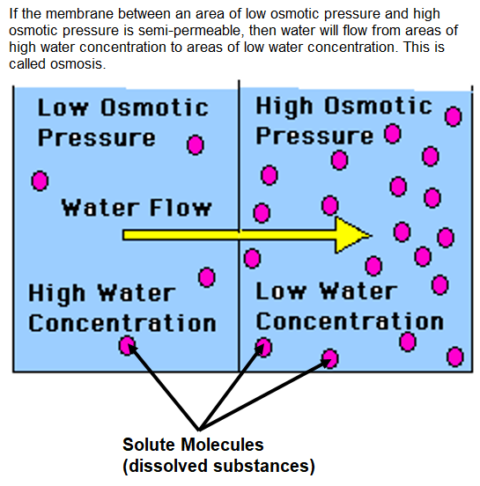
Osmotic Pressure
Osmotic pressure is a measure of concentration of dissolved substances vs water.
Body fluids with HIGH OSMOTIC PRESSURE have high solute concentration and low water concentration (like strong cordial)
Body fluids with LOW OSMOTIC PRESSURE have low solute concentrations and high water concentration (like dilute cordial)
Osmoreceptors in the hypothalamus detect osmotic pressure (ie how concentrated the solutes in the blood are)

Slide 11
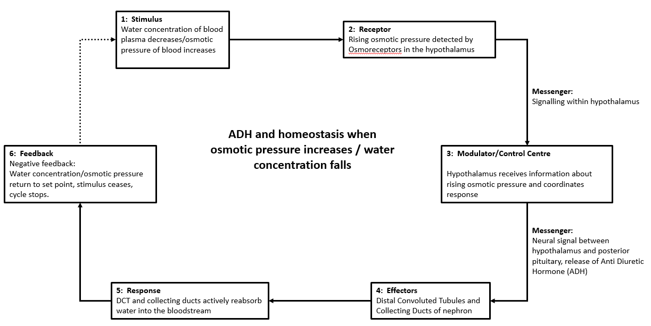
Homeostatic mechanisms when osmotic pressure increases: ADH

Slide 12
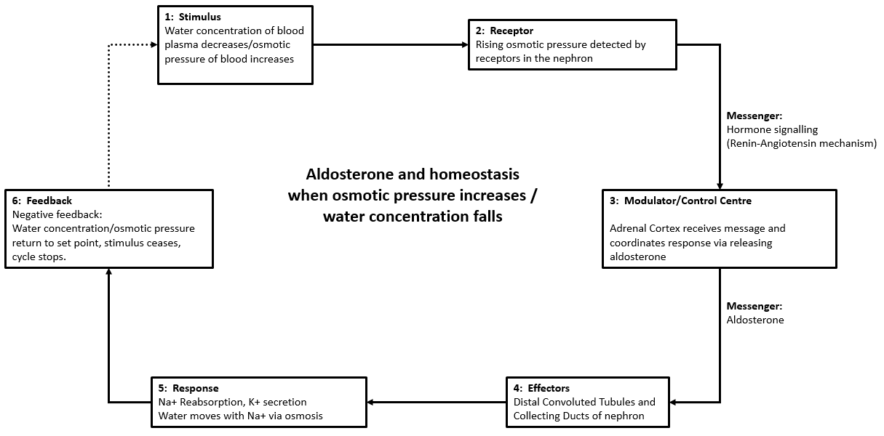
Homeostatic mechanisms when osmotic pressure increases: Aldosterone

Slide 13
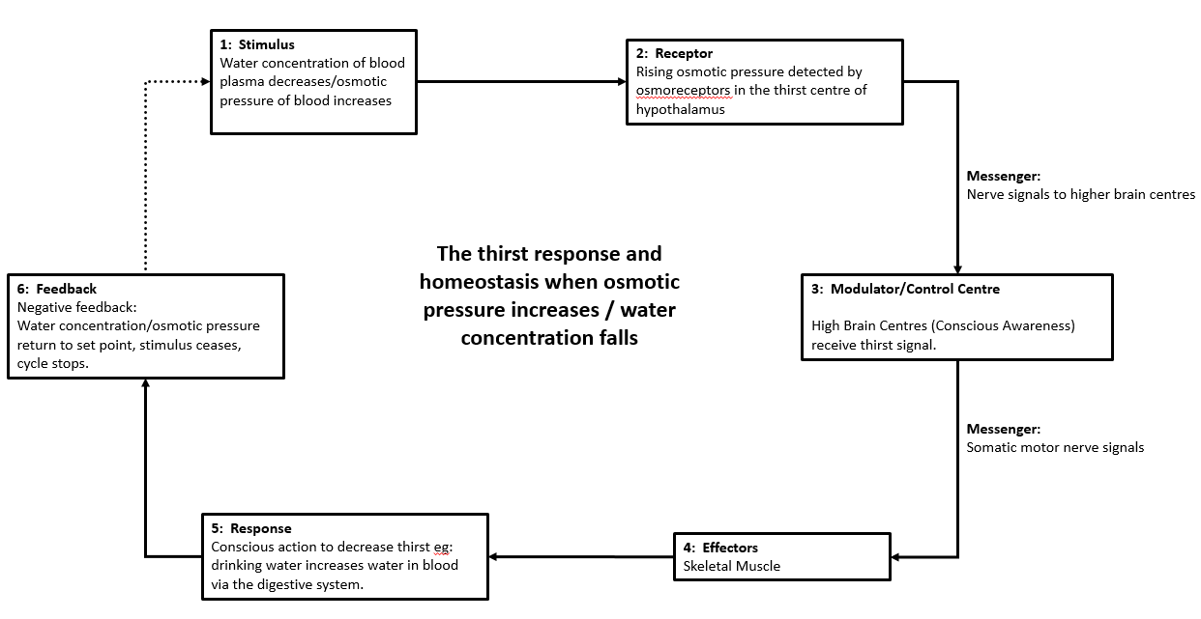
Homeostatic mechanisms when osmotic pressure increases: Thirst Response

Slide 14
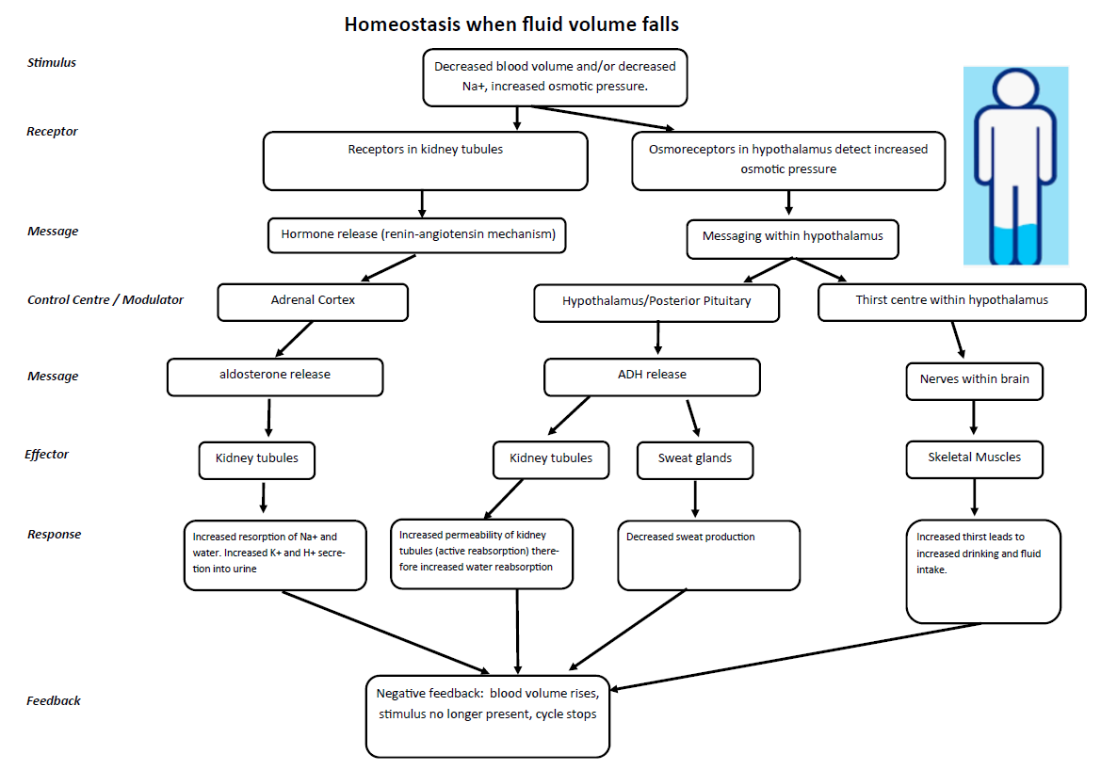

Slide 15
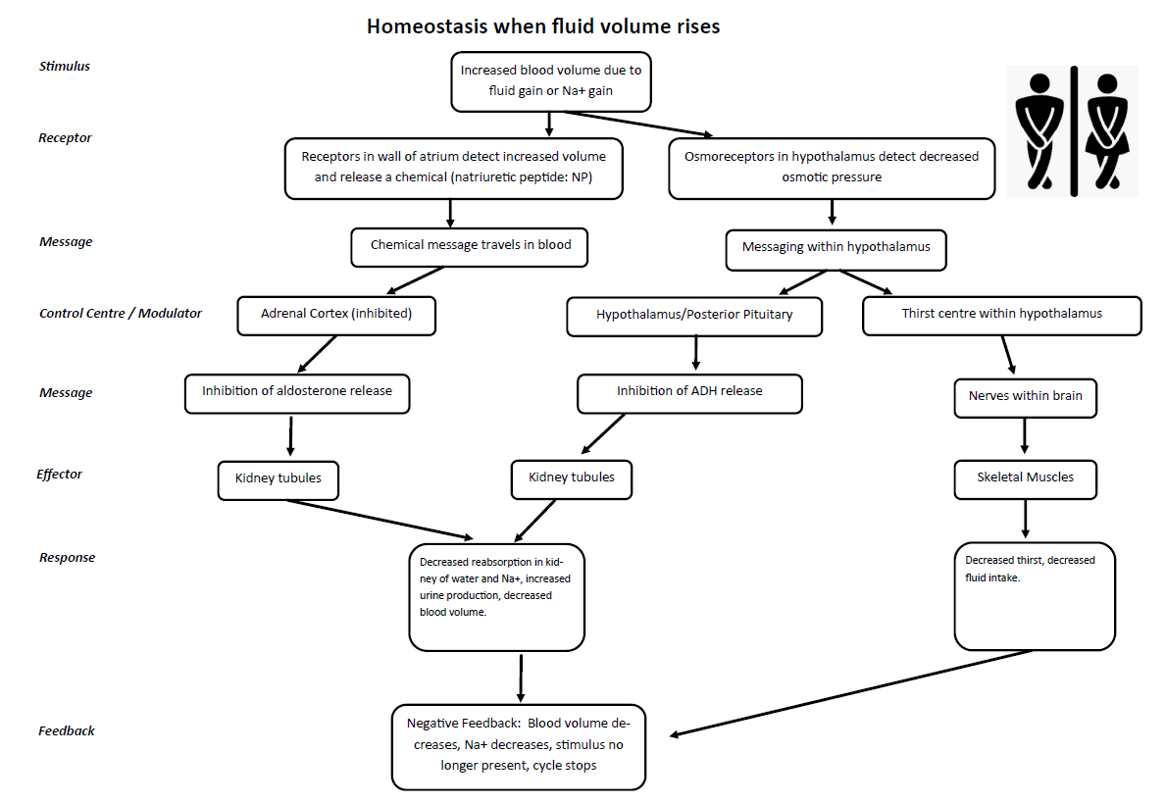
Homeostasis when water concentration rises/osmotic pressure falls.
When fluid intake rises, water concentration rises, and osmotic pressure falls.
Homeostatic response is to inhibit ADH and Aldosterone release, and the thirst response, so that water and Na+ are not reabsorbed, no new water is taken in, and the nephron can remove excess water into urine.

Slide 16
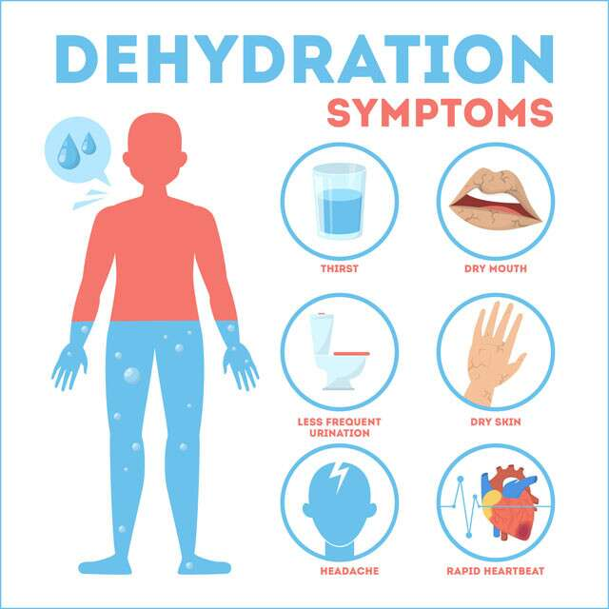
Increase in osmotic pressure beyond tolerance limits
Dehydration
Noticeable when 2% of body water is lost
Due to:
Sweating
Vomiting
Diarrhoea
Evaporation from lungs etc
Symptoms
Severe thirst
Low blood pressure
Dizziness
Headache
Delirium
Unconsciousness
DEATH
Treatment
Replacement of fluids via IV drip with fluid AND electrolytes
Electrolyte drinks

Slide 17
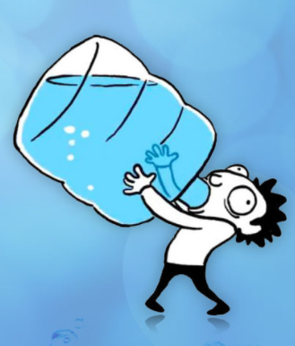
Decrease in osmotic pressure beyond tolerance limits
“Water Intoxication” (also called hyponatremia)
Too much water intake
More than can be excreted by kidneys to maintain balance of fluid and salts
Occurs where water AND salts are lost, but only water is drunk to replace.
Marathon runners
Extreme athletes
Or where water is drunk well beyond thirst quenching needs
Idiots
Low ion concentration in blood and interstitial fluid causes water to move into cells via osmosis, causing cells to swell – this is a problem, especially in the brain!
Symptoms
Light-headedness
Headache, vomiting , collapse
DEATH
Treatment
Antidiuretic medication, but often fatal if severe.

